Slide 1


Data Warehouse with MongoDB
Migration from RDBMS to MongoDB
2018.09 ~ 2018.10
Muthu Ramakrishnan, Avinash Singh, Olga Arsenieva, Jongkuk Lee
https://github.com/Gs1TestTeam/MongoDB_Task/wiki

Slide 2
1. Schedule
Planning
Schema Design
Data Migration
Supply
Operating
Planning
Enablement
Data Model
Index
Script
ETL
Business
Intelligence
Backups
Archiving
Historical
Week1
Week2
Week3 ~ 5
Week6
Week7 ~ 8
Business Requirement
Essential features
Setup Cloud Env
Install MongoDB
Install GUI tools
License
Required resource
Schema Design Guide
Field Mapping Chart
Index
ETL tools:
Extract, Transform, Load
1) SSIS: SQL Server
Integration Service
2) Apache Nifi
MongoDB Aggregation
BI tools:
1) Tableau
2) Power BI
MongoDB BI Connector
Backup&Recovery
Archiving&Purge
Historical Data
- Changes Stream
Documenting

Slide 3
2. To-Do list
https://github.com/Gs1TestTeam/MongoDB_Task/projects/1
Summary
Plan | Progress | Done | Delete
21 | 3 | 12 | 6
Detail
No | Week | Task | Output | Status
1 | Week1 (Planning) | Research MongoDB Essential features | https://github.com/Gs1TestTeam/MongoDB_Task/wiki/1.0-Essentials | Complete
2 |  | Setup Cloud Env & GUI tools | https://github.com/Gs1TestTeam/MongoDB_Task/wiki/1.2-GUI-Application https://github.com/Gs1TestTeam/MongoDB_Task/wiki/1.3-Installation-and-Cloud-Service | Complete
3 |  | Research license, server required resource | https://github.com/Gs1TestTeam/MongoDB_Task/wiki/1.1-Infrastructure https://github.com/Gs1TestTeam/MongoDB_Task/wiki/1.4-License https://github.com/Gs1TestTeam/MongoDB_Task/wiki/1.5-Data-Storage | Complete
4 | Week2 (Schema Design) | Create MongoDB Schema Design Guideline | https://github.com/Gs1TestTeam/MongoDB_Task/wiki/2.0-Schema-Design | Complete
5 |  | Create Schema Design Mapping Chart |  | Complete
6 |  | Write MongoDB schema using JSON format |  | Complete

Slide 4
2. To-Do list
No | Week | Task | Output | Status
7 | Week3 ~ Week5 (Data Migration) | Research ETL (Extract, Transform, Load) tools | https://github.com/Gs1TestTeam/MongoDB_Task/wiki/2.1-ETL-Tool | Complete
8 |  | Create collections on MongoDB | https://github.com/Gs1TestTeam/MongoDB_Task/wiki/2.2.3-Migration-using-Apache-NiFi https://github.com/Gs1TestTeam/MongoDB_Task/wiki/2.2.1-Migrating-from-MS-SQL-to-MongoDB-using-SSIS https://github.com/Gs1TestTeam/MongoDB_Task/wiki/2.2.2-Migrating-from-MySQL-to-MongoDB-using-SSIS | Complete
9 |  | Test Migration RDB to MongoDB |  | Complete
10 | Week6 (Supply) | Research MongoDB BI Connector | https://github.com/Gs1TestTeam/MongoDB_Task/wiki/2.2.5.--Consuming-Migrated-Data | Complete
11 |  | Power BI tool with MongoDB |  | Complete
12 |  | Tableau with MongoDB |  | Complete
13 | Week7 ~ Week8 (Operating) | Backup&Recovery | https://github.com/Gs1TestTeam/MongoDB_Task/wiki/4.0-Backup-and-Restore | Complete
14 |  | Historical data/Archiving & Purge data | https://github.com/Gs1TestTeam/MongoDB_Task/wiki/3.1-Historical-Data-Management | Progress
15 |  | HA/Scalability (Replication and Shading) |  | Progress
16 |  | Documentation |  | Progress

Slide 5
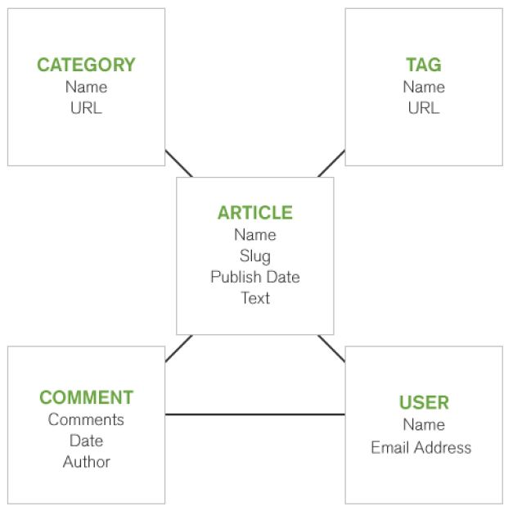
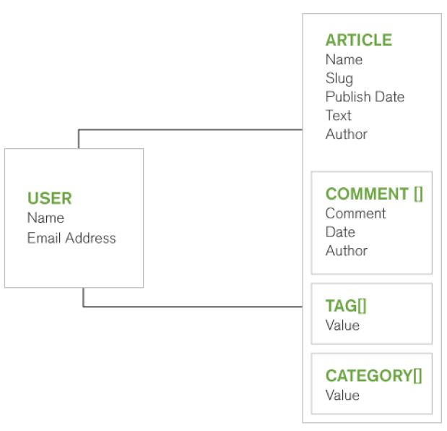
3. MongoDB
- MongoDB is the most popular document based database
- Include many modern computing technology such as Parallel Processing, Pipeline, Powerful aggregation, Modern JS …
- Document DB can store document informative format such as Xml, JSON, and any binary files (BSON)
- BSON is Binary JSON and JSON-Like Format, created by native language “C”, can store primitive and Object type both
- RDBMS is optimized in effective use of storage by normalizing
- MongoDB is optimized in query and development speed by embedding structure
[MongoDB Essential]
https://github.com/Gs1TestTeam/MongoDB_Task/wiki/1.0-Essentials
[MongoDB Doc]
https://docs.mongodb.com/manual/
Convert structure to MongoDB
[RDBMS]
- Data is discrete in several tables​
- Complex to select
[MongoDB]
- Data can be stored in only an object​
- Easy to handle

Slide 6
4. ETL tools (Data Migration Tool)
(Extract, Transform, and Load data)
SSIS (SQL Server Integration Service)
- Data Flow-Based Development (FBD)
- Component based programming
- Data migration tool
- Provided by Microsoft
- Easy to learn and use
- Not free
- Need third party components
for MongoDB (Not free)
Apache NiFi (Niagara Files)
- Data Flow-Based Development (FBD)
- Component-based Development (CBD)
- Can use it as Data Migration Tool
- Provided by Apache Project
- Hard to learn and use
- Free
- Embed Web Server (Jetty), independently service
Apache NiFi on GitHub Wiki:
https://github.com/Gs1TestTeam/MongoDB_Task/wiki/2.2.3-Migration-using-Apache-NiFi.
Apache Official Web Site:
https://nifi.apache.org
https://nifi.apache.org/docs.html

Slide 7
5. Data Migration Procedure
Start
Description
Guideline
Role
Schema Design
• Change Schema Structure
from RDBMS to MongoDB
• How to collapse 2 RDBMS Tables
to 1 BSON Documents
Fix
Mapping
• Create Schema Mapping Table
• Schema mapping chart.xml
Fix Schema Mapping Chart
NO
Review
• Review Schema Mapping Table
If pass then move to next step
else move back to previous step
• Manual Check
OK
• Implement Migration App
using Apache NIFI tool
• Migration using Apache NIFI
Implement
Fix
Migrating
• Migrate data
from RDB to MongoDB
using Apache NIFI tool
• Migration using Apache NIFI
Fix Apache NIFI Template File
Delete Data
NO
Quality
• Check Migrated Data Quality
If pass then move to next step
else move back to previous step
• Migration and Quality Check
OK
End

Slide 8
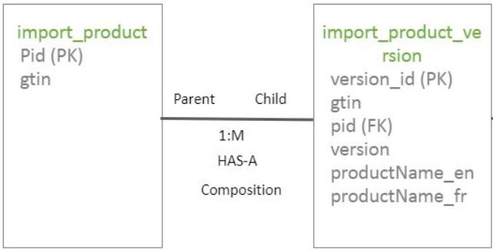
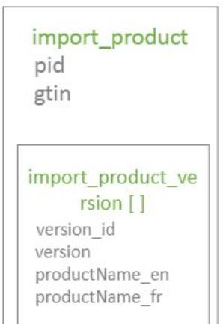
5. Data Migration Procedure
5-1. Design Schema Structure
To Determine Schema Structure
• 1:1 or 1:many relationship can be candidates for embedding structure
(Parent-Child relationship, HAS-A relationship, Composition relationship)
• Many-to-many relationship can be candidates for referencing structure
• Follow to the organization’s data policy
(Example)
how to collapse 2 RDBMS Tables to 1 MongoDB Documents
• import_product, import_product_version tables
• 1:many relationship
• Embedding structure
RDBMS
MongoDB

Slide 9
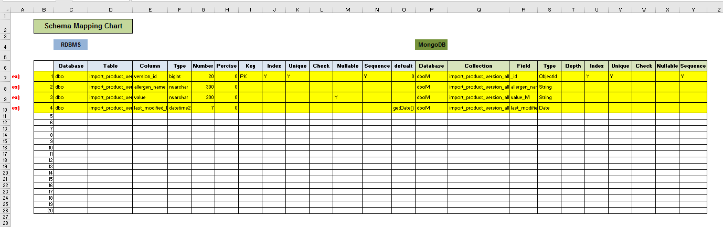
5. Data Migration Procedure
5-2. Data Mapping
Example: Map fields of import_product, import_product_version tables to one MongoDB's collection
https://github.com/Gs1TestTeam/MongoDB_Task/blob/master/doc/Schema_Mapping_Chart_Ver_3.xlsx

Slide 10
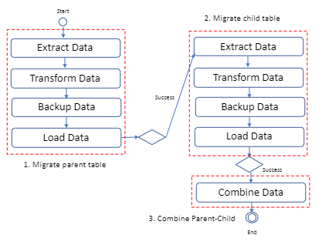
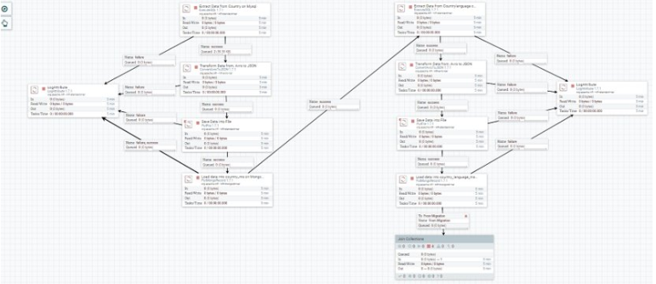
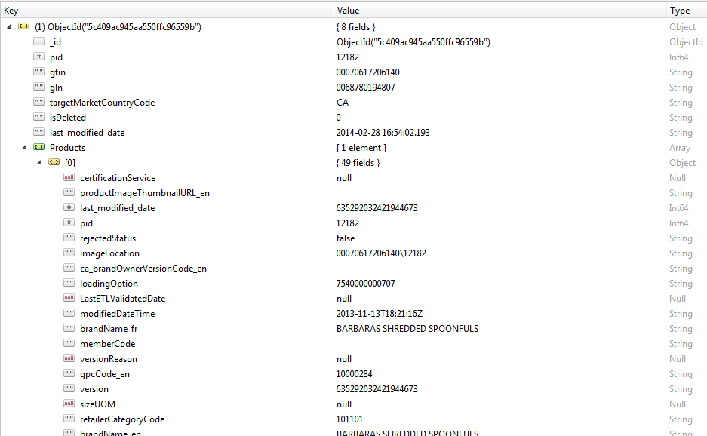
5. Data Migration Procedure
5-3. Implementing and Migrating
Design Diagram
Implement and execute
Result

Slide 11
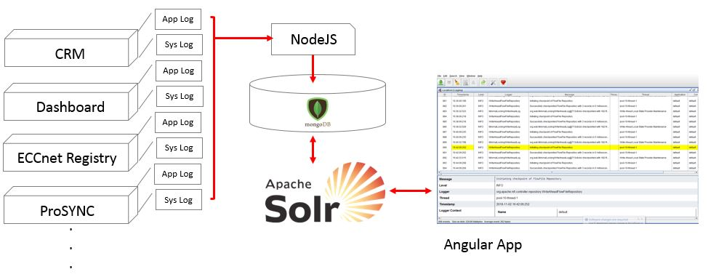
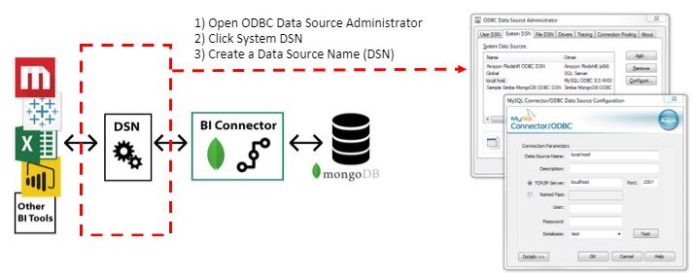
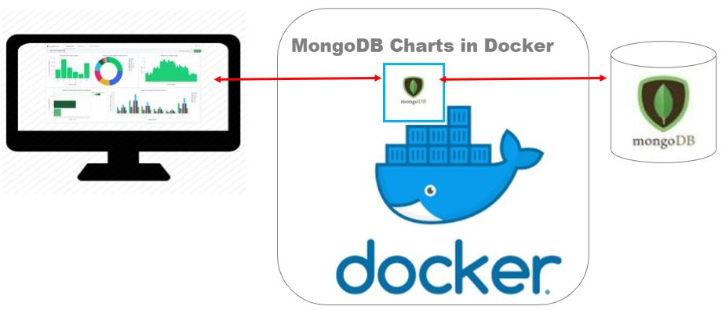
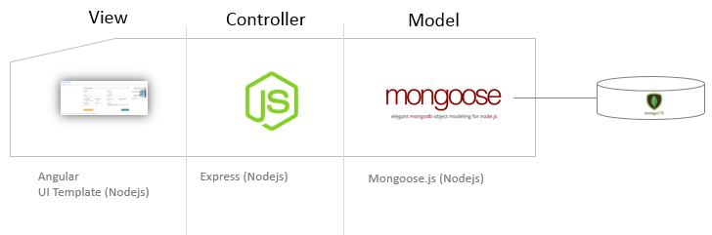
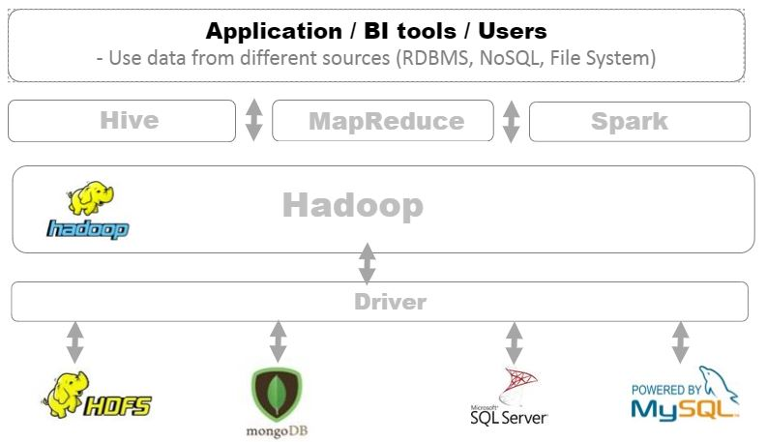
6. Utilize Data in MongoDB
App/Sys
log
MongoDB can be used as log file storage
like a Time Series DB
MongoDB Connector for Business Intelligence (BI) allows users to create queries with SQL and visualize, graph, and report on their MongoDB Enterprise data using existing relational business intelligence tools such as Tableau, Power BI, MicroStrategy, and Qlik
Business
Intelligence
MongoDB Charts is a tool to create visual representations of your MongoDB data
Application
/ Backend
Data
Supply
Dashboard
/ Chart
Historical
Data
MongoDB Change streams allow applications to access real-time data changes without the complexity
MongoDB can be a part of Big Data solution:
• A good response data lake
• Parallel Stream processing, powerful aggregation functions
• Easily summarize data in real-time without batch jobs
• Combine with the existing Big Data solution such as Hadoop, Spark
With MongoDB, build data marketplace

Slide 12

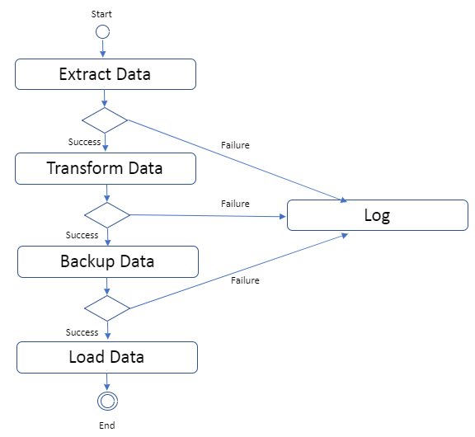

7. Demo
7-1. Migrating 1GB Data from SQL Server to MongoDB with Apache NiFi
Scenario:
1) 1 GB size Table on SQL server
2) Migrate it to one collection on MongoDB
Migration Strategy:
1) Extract 1GB data from SQL Server
2) Transform data to JSON format
3) Backup JSON data (Option)
4) Load Data to MongoDB
SQL Server
on Remote Machine
Apache NiFi
on Localhost Machine
MongoDB
on Localhost Machine
Demo Video:
https://gs1ca.sharepoint.com/portals/hub/_layouts/15/PointPublishing.aspx?app=video&p=p&chid=1baba4ce-83a9-4d99-ad67-d8e582819c69&vid=c7e5e551-c804-4e25-afbe-8c2f93699436

Slide 13
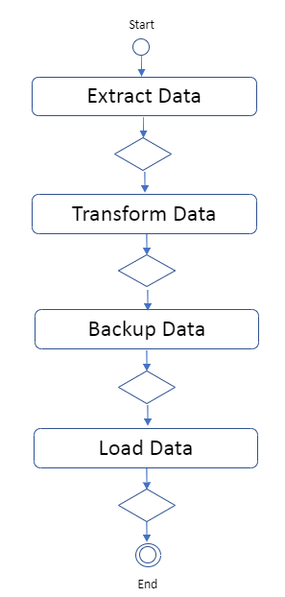
7. Demo
7-1. Migrating 1GB Data from MySQL to MongoDB with Apache NiFi
[Performance Analysis]
Diagram | Time (mm:ss) |  |  | CPU (%) |  |  | Memory (MB)
 | 1st | 2rd | 3rd | 1st | 2rd | 3rd | 1st | 2rd | 3rd
 | 1:35 | 1:27 | 1:28
 | 1:45 | 2:04 | 1:19
 | 1:47 | 1:50 | 1:22
 | 6:36 | 8:32 | 4:56
Total | 11:43 | 13:53 | 9:05
Storage size: 1.2GB (RDBMS), 586 MB (MongoDB) because MongoDB compresses data to store from MongoDB 3.0
by using “WireTiger”, which is tools for managing MongoDB disk in efficiency

Slide 14
7. Demo
7-2. Migrating Data from SQL Server to MongoDB with Apache NiFi
Scenario:
1) import product, import_product_version Tables
on SQL server
2) Collapse to one collection on MongoDB
Migration Strategy:
1) Design Schema Structure
2) Migrate data on a parent-table to MongoDB
3) Migrate data on a child-table to MongoDB
4) Combine two separate collections
to one-embedding structure collection
(1. aggregation to join, 2. insert the combined data)
SQL Server
on Remote Machine
Apache NiFi
on Localhost Machine
MongoDB on Cloud
Demo Video:
Result:
https://gs1ca.sharepoint.com/portals/hub/_layouts/15/PointPublishing.aspx?app=video&p=p&chid=1baba4ce-83a9-4d99-ad67-d8e582819c69&vid=f414f671-87da-4a03-ad9b-200f924b304e
SQL Server |  | MongoDB
product | Product_version | Product_m | Product_version_m | combined
32434 | 45241 | 32434 | 45241 | 32434

Slide 15
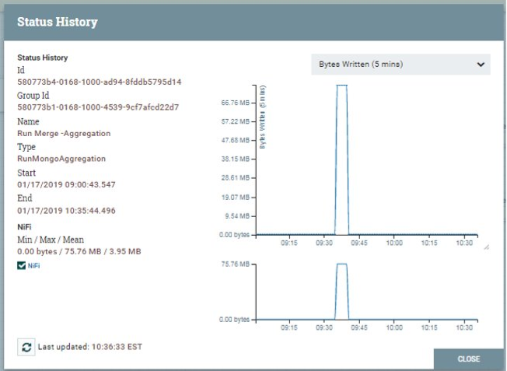
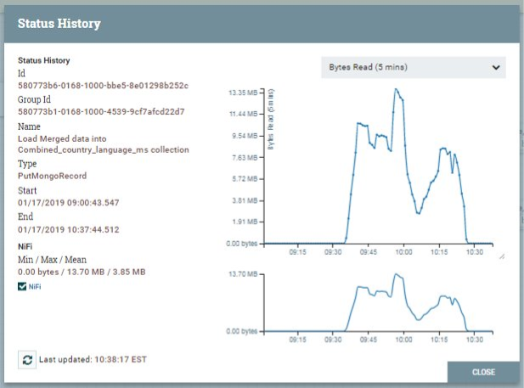
7. Demo
7-2. Migrating Data from SQL Server to MongoDB with Apache NiFi
(RunMongoAggregation: about 5 minutes)
(PutMongoRecord: about 60 minutes)

Slide 16
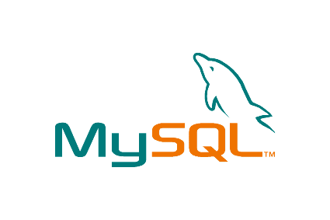
7. Demo
7-3. Migrating Data from MySQL to MongoDB with Apache NiFi
Scenario:
1) country, country_language Tables on MySQL
2) Collapse to one collection on MongoDB
Migration Strategy:
1) Design Schema Structure
2) Migrate data on a parent-table to MongoDB
3) Migrate data on a child-table to MongoDB
4) Combine two separate collections
to one-embedding structure collection
Country
Code (PK)
Name
MySQL
on Remote Machine
Country_Lanuage
CountryCode (PK)
CountryName
Country
Code (PK)
Name
…
Country_Lanuage
CountryCode (PK)
CountryName
…
Parent-Child
1:m
Has A
Composition
Apache NiFi
on Localhost Machine
MongoDB on Cloud
Demo Video:
Result:
https://gs1ca.sharepoint.com/portals/hub/_layouts/15/PointPublishing.aspx?app=video&p=p&chid=1baba4ce-83a9-4d99-ad67-d8e582819c69&vid=1defd8f4-3d5f-48f0-ab0c-32e57981932b
MySQL |  | MongoDB
country | language | country_m | language_m | combined
237 | 913 | 237 | 913 | 237

Slide 17
7. Demo
7-3. Migrating Deltas Data from MySQL to MongoDB with Apache NiFi
Scenario:
1) country, country_language Tables on MySQL
2) migrate all data on Jan 16
3) migrate deltas data on Jan 17
Migration Strategy:
1) Copy the previous processors
2) Change Extract data Query WHERE clause
extract data from last_upldate_date > now() – 1 day
2) Change schedule to CRON type
3) Set the PERIODIC TIME
ex: 16:31 every day
4) Run and Wait running the batch job at 4:31 pm every day
5) Check deltas on MongoDB before/after running batch job
Changes after Migration
Run Periodic CRON job
Demo Video:
Result:
https://gs1ca.sharepoint.com/portals/hub/_layouts/15/PointPublishing.aspx?app=video&p=p&chid=1baba4ce-83a9-4d99-ad67-d8e582819c69&vid=c263acbb-aa0c-418f-a05f-171a3c0b6741
Time | MySQL |  | MongoDB
 | country | language | country_m | language_m | combined
Jan 16, 11:45 | 236 | 912 | 236 | 912 | 237
Jan 17, 11:45 | 237 | 913 | 236 | 912 | 237
Every 16:31 | 237 | 913 | 237 | 913 | 237

Slide 18
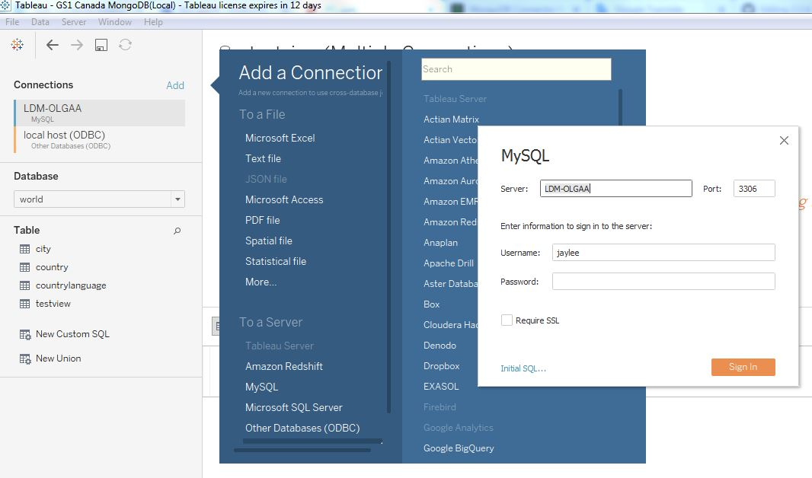
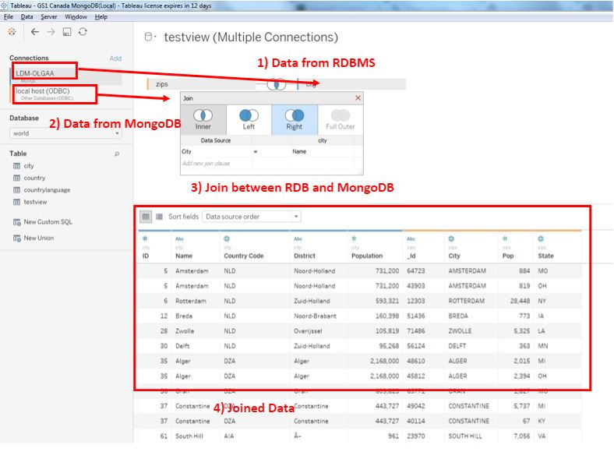
7. Demo
7-4. Connect to MongoDB with the Existing BI Tools
To test BI Connector, we need four components:
1. MongoDB database: Data storage.​
2. BI Connector: Provides a relational schema and translates SQL queries between your BI tool and MongoDB.​
3. ODBC data source name (DSN): Holds authentication and connection configuration data.​
4. BI Tool: Data visualization and analysis.​
Quick Test
1. Set up MongoDB, ODBC, BI connector
2. Start Mongod and Mongosqld, which helps to use SQL language in the BI tools
3. Connect to MySQL and MongoDB using Power BI
(Embedding structure on MongoDB is broken down to tables on BI tools)
4. Outer Join data between RDBMS and MongoDB (like relational DB)
5. Check the abnormal data
6. Create statistics
Demo Video:
https://gs1ca.sharepoint.com/portals/hub/_layouts/15/PointPublishing.aspx?app=video&p=p&chid=1baba4ce-83a9-4d99-ad67-d8e582819c69&vid=6fbf0662-a6f7-41fc-bff2-c9a1b5e9e095
- Receive SQL query
- Change it to mongo query
- Send the result as a tabular format

Slide 19

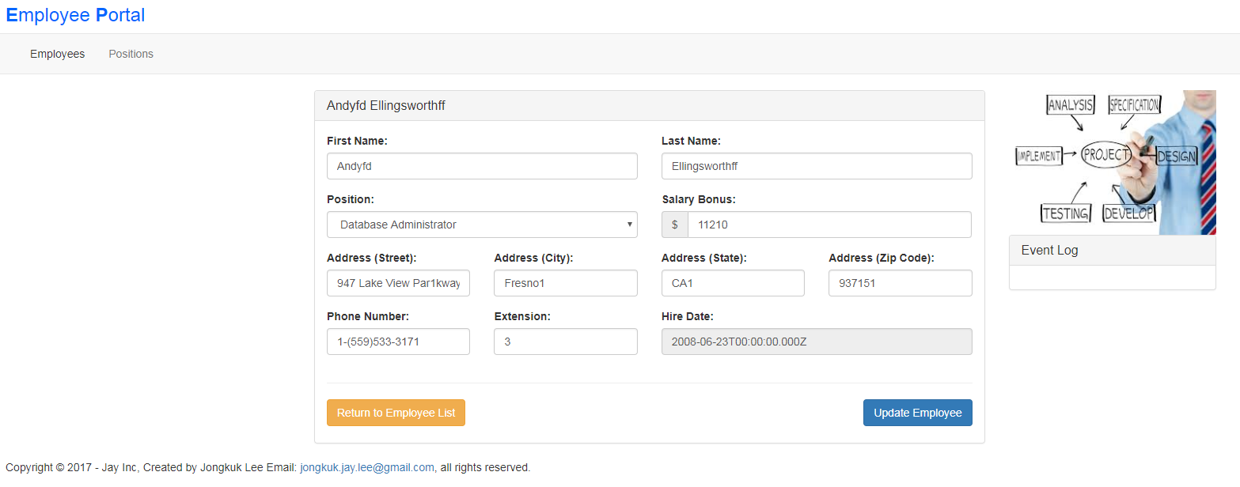

7. Demo
7-5. Angular Application with MongoDB
View
Controller
Model
Angular
UI Template (Nodejs)
Express (Nodejs)
Mongoose.js (Nodejs)
Demo:
https://github.com/Gs1TestTeam/PMSProject/tree/patch-1
https://fast-earth-31699.herokuapp.com/employees

Slide 20
7. Demo
7-6. Backup and Recovery on MongoDB
1. Run "mongodump" command from bin of MongoDB installation
2. Dump folder create at location given after --out parameter
3. Dump folder contains collections in BSON format
4. Imitate loss of data by dropping a collection
5. Run "mongorestore" command from bin of mongodb installation
With --drop option to recreate database from dump folder
Demo Video:
https://gs1ca.sharepoint.com/portals/hub/_layouts/15/PointPublishing.aspx?app=video&p=p&chid=1baba4ce-83a9-4d99-ad67-d8e582819c69&vid=8c6fc5b7-0763-4d0c-8b79-d804896849c3

Slide 21
8. Sum up
• MongoDB is one of the popular document-based databases, which includes modern technology paradigms such as parallel, streaming, aggregation, map reduce and so on.
• MongoDB is optimized in query and development speed rather than in storage management.
• Apache NiFi is an open source framework to migrate data from RDBMS to MongoDB.
• With MongoDB and Apache NiFi, we can effectively migrate, store, summarize large scale data in quick response. So, MongoDB is a very powerful data lake, and can be combined to the existing Big data solutions.
• MongoDB providers business support products such as MongoDB BI connector and chart tool.
• MongoDB BI connector tool helps user utilize data on MongoDB with the SQL-based BI tools, without knowledge about MongoDB.
• MongoDB Chart tool helps user easily visualize data and create dashboard.

